Slide 1
Lecture 10b
Recurrent Neural Networks (RNN)

Slide 2
Outline
Running versus walking
Use VGG (no memory) to classify motion
Use ”simple” RNN to classify
Concatanate 2 images (frames)
Use feedback in hidden layers
Use feedback from output to hidden layer
Use feedback from output to hidden layer (3 frames)
Explain annoying diagrams
Convolutional LSTM

Slide 3
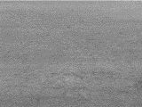
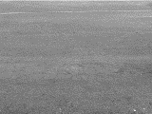
Running vs Walking
100 video clips for running and 100 video clips for walking.
Various frames (200 to 800), 10 frames taken from each video.
Schuldt, C., Laptev, I., & Caputo, B. (2004, August). Recognizing human actions: a local SVM approach. In Proceedings of the 17th International Conference on Pattern Recognition, 2004. ICPR 2004. (Vol. 3, pp. 32-36). IEEE.

Slide 4
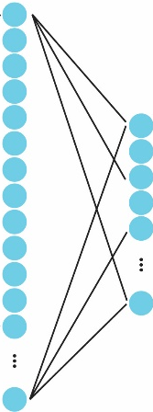
VGG – single frame
Flatten
3600
Image
120x160
Conv1
120x160x4
Hidden
32
Conv2
60x80x8
Conv3
30x40x12
MaxPool
(2,2)
MaxPool
(2,2)
MaxPool
(2,2)
500 train, 100 test
Adam (lr=0.001)
20 epoch, batch size=20
Dropout=0.4 (at hidden layer)

Slide 5
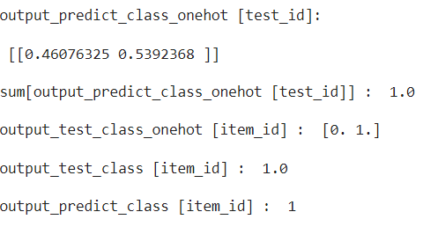
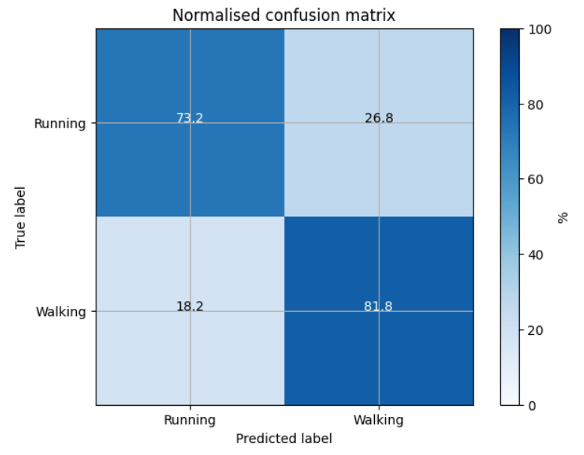
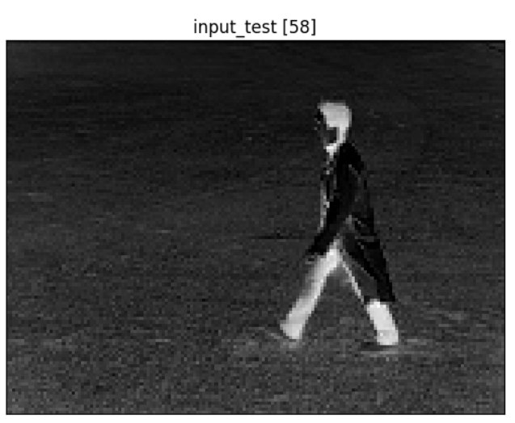
VGG – single frame
Test accuracy: 77%

Slide 6
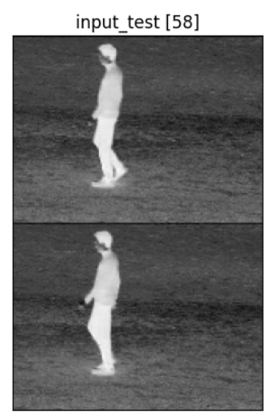
VGG – two frames concatenated
Flatten
Conv1
240x160x4
Hidden
32
Conv2
120x80x8
Conv3
60x40x12
Conv4
30x20x16
Image
120x160
MaxPool
(2,2)
MaxPool
(2,2)
MaxPool
(2,2)
MaxPool
(2,2)
240x160

Slide 7
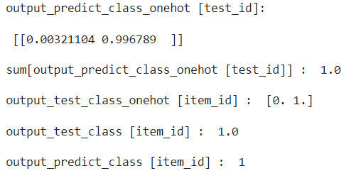
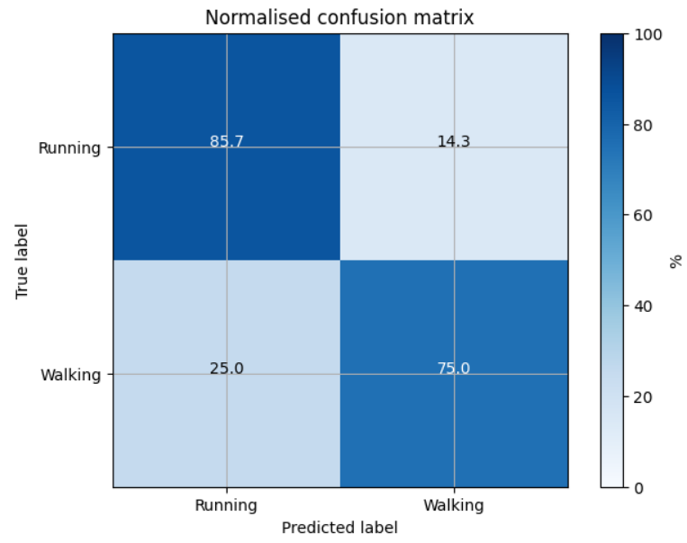
VGG – two frames
Concatenate two frames at the input (size: 240x160)
Test accuracy: 81%
Recall, single-frame VGG gives 77%

Slide 8
Simple RNN unit – concatenate+FC
RNN, 1-unit input
RNN, 2-unit input
h(t)
h₁(t)
h₂(t)
Fully Connected
Concatenate
h(t-1)
h₁(t-1)
x(t)
x₁(t)
x₂(t)
h₂(t-1)

Slide 9
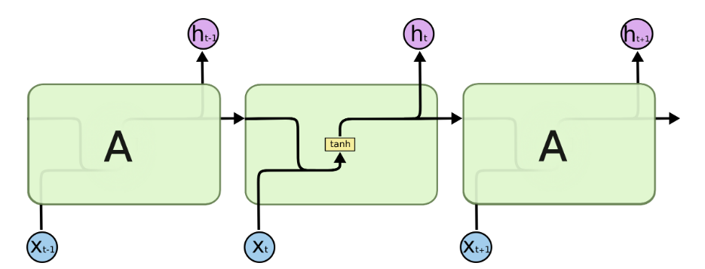
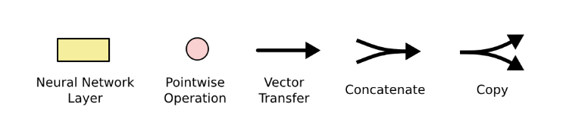
Simple RNN unit
Standard RNN
unfolded diagram
h(t)
h(t-1)
x(t)
Legend:

Slide 10
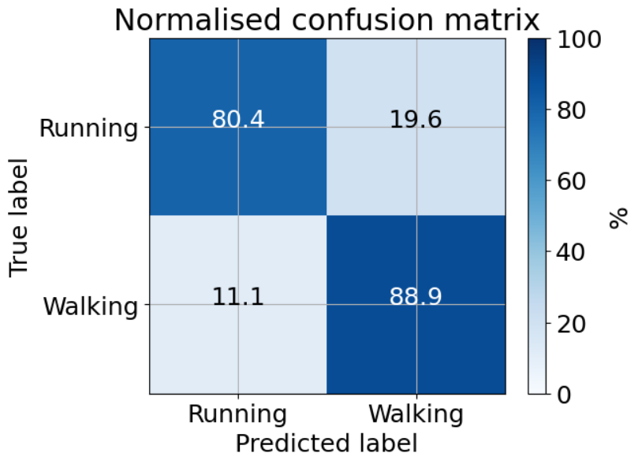
Simple RNN hidden layer at t is concatenated with hidden layer at t-1
CNN-RNN
Flatten
3600
Conv1
120x160x4
Hidden
32
Conv2
60x80x8
Conv3
30x40x12
Test accuracy: 85%
MaxPool
(2,2)
MaxPool
(2,2)
MaxPool
(2,2)
Image
120x160
Recall, single-frame VGG gives 77%

Slide 11
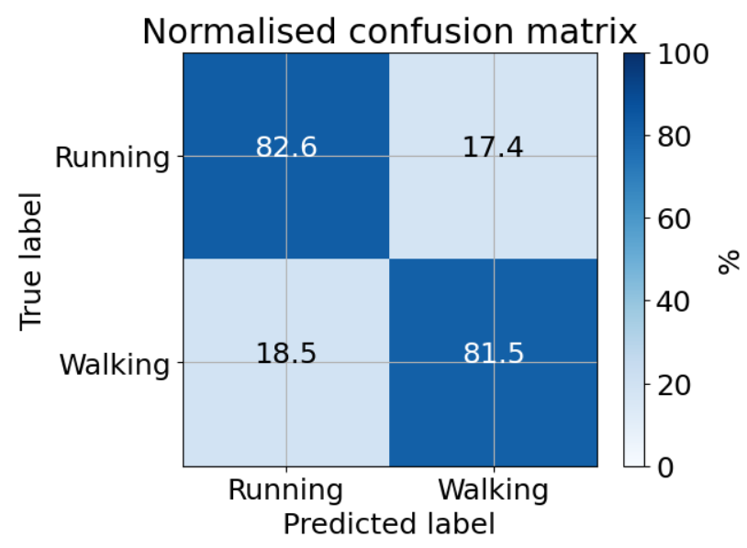
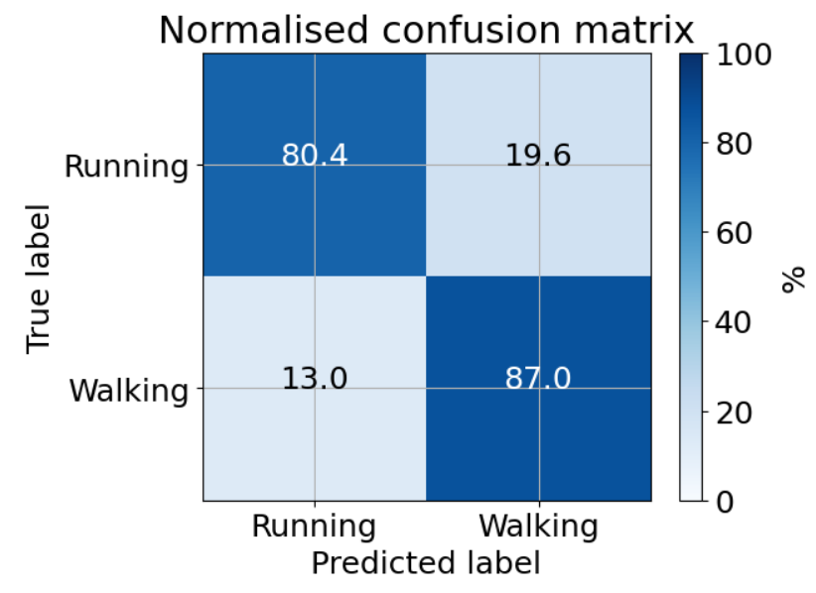
Simple RNN – 2 frames
CNN-RNN
Flatten
3600
N=32, test accuracy: 82%
Conv1
120x160x4
Hidden
N
Conv2
60x80x8
Conv3
30x40x12
MaxPool
(2,2)
MaxPool
(2,2)
MaxPool
(2,2)
N=64, test accuracy: 84%
Image
120x160
Recall, single-frame VGG gives 77%

Slide 12
Simple RNN – 2 frames
CNN-RNN
Flatten
3600
Conv1
120x160x4
Hidden
32
Conv2
60x80x8
Conv3
30x40x12
Test accuracy: 88%
MaxPool
(2,2)
MaxPool
(2,2)
MaxPool
(2,2)
Image
120x160
32
…
Recall, single-frame VGG gives 77%

Slide 13
Simple RNN – 2 frames
CNN-RNN
Flatten
3600
Conv1
120x160x4
Hidden
32
Conv2
60x80x8
Conv3
30x40x12
Test accuracy: 90%
MaxPool
(2,2)
MaxPool
(2,2)
MaxPool
(2,2)
Image
120x160
32
…
Recall, single-frame VGG gives 77%

Slide 14
Simple RNN – 3 frames
CNN-RNN
Flatten
3600
Conv1
120x160x4
Hidden
32
Conv2
60x80x8
Conv3
30x40x12
Test accuracy: 92%
MaxPool
(2,2)
MaxPool
(2,2)
MaxPool
(2,2)
Image
120x160
…
32
32
…
Recall, single-frame VGG gives 77%

Slide 15
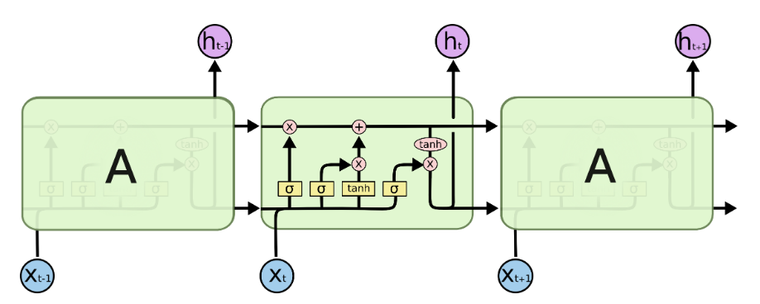
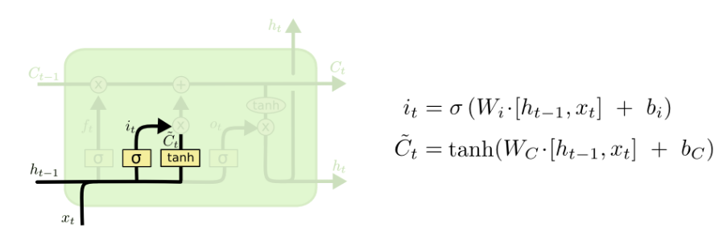
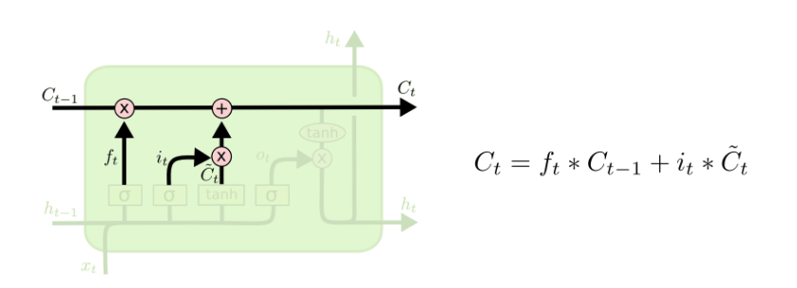
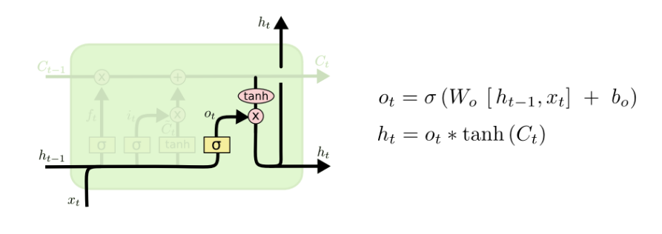
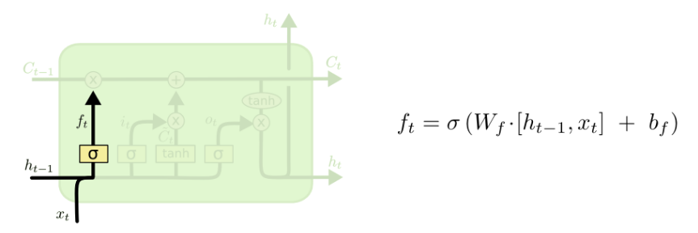
Simple LSTM annoying diagram
Legend:
Forget Gate
Input Gate
Update the cell state (memory)
Output

Slide 16
Long Short-Term Memory (LSTM)
LSTM, 1-unit input
h(t)
MEMORY
C(t)
h(t)=o(t) x tanh(C(t))
C(t)=f(t)C(t-1)+i(t)c(t)
C(t-1)
i(t)c(t)
f(t)C(t-1)
o(t)
i(t)
c(t)
σ
σ
f(t)
tanh
σ
Weights
h(t-1)
x(t)

Slide 17
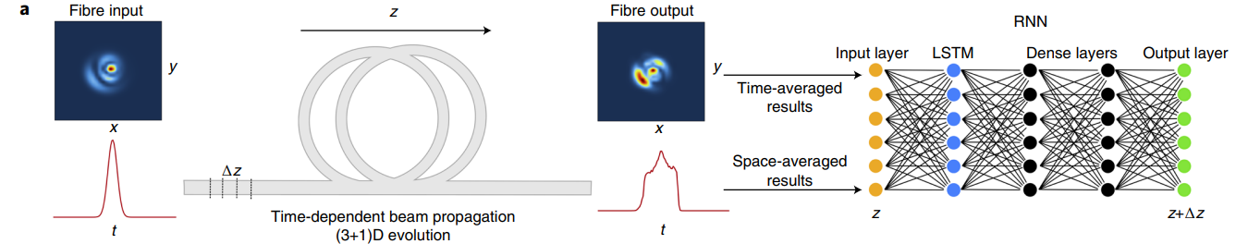
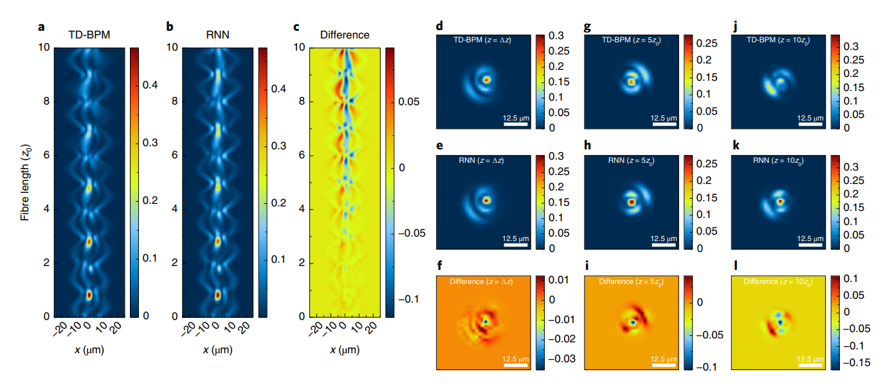
LSTM example
Teğin, U., Dinç, N. U., Moser, C., & Psaltis, D. (2021). Reusability report: Predicting spatiotemporal nonlinear dynamics in multimode fibre optics with a recurrent neural network. Nature Machine Intelligence, 3(5), 387-391.

Slide 18
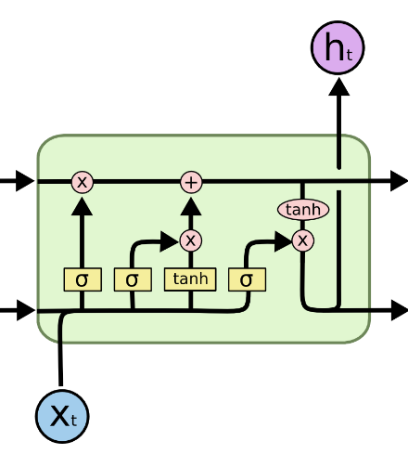
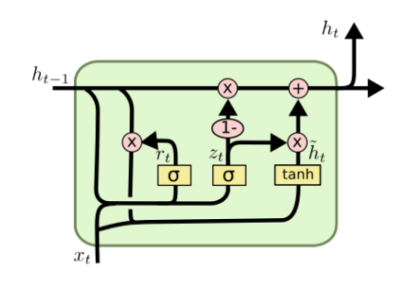
Long Short Term Memory
(LSTM)
Gated Recurrent Unit
(GRU)
C_{t-1}
C_{t}
h_{t-1}
h_{t}
Changes:
Forget and input gates are combined in a single update gate
Cell state and hidden states are merged
Advantage: less parameters -> faster training and easier generalization

Slide 19
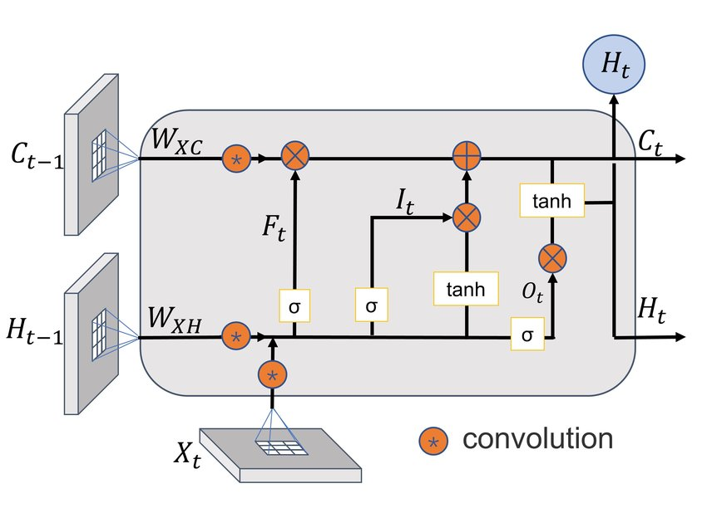
ConvLSTM2D
Conventional RNNs work with 1D arrays (flattened vectors)
In ConvLSTM2D, fully connected layers are replaced with 2D convolutions.
Suited for next frame prediction
Shi, X., Chen, Z., Wang, H., Yeung, D. Y., Wong, W. K., & Woo, W. C. (2015). Convolutional LSTM network: A machine learning approach for precipitation nowcasting. Advances in neural information processing systems, 28.

